Slide 1
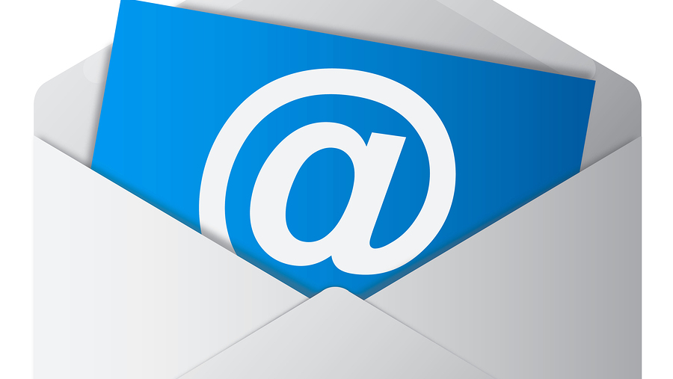
Email Marketing
Spencer Hintze

Slide 2
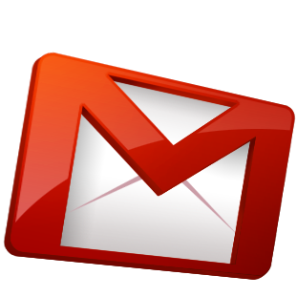
Overview
Intro
Strategies
Optimization
Maintenance

Slide 3
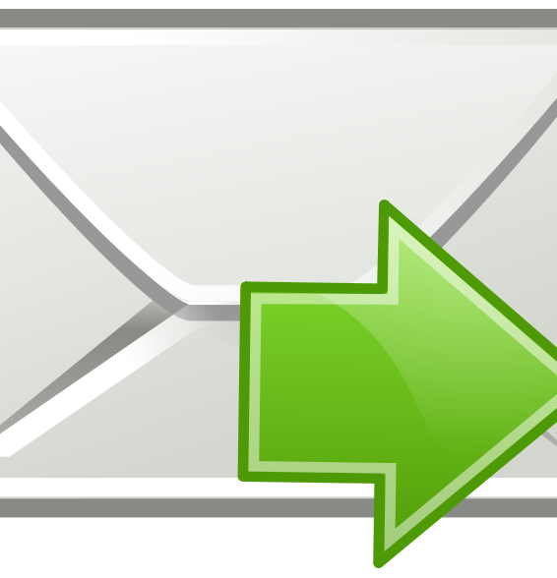

Introduction
What?
Why?
Where?
Notes:
What?
The use of email messages sent to a list of subscribers to advertise or promote brands, products, offers, events or pretty much anything you want.
Why?
Extremally important in the marketing world today.
Average return on investment for email marketing is $38:$1
Not even social media comes close. Leads are 2x as likely to opt-in to email list than they are to engage on Facebook.
Email conversion rates are higher than search and social combined.
Where?
Many platforms that work
Once a platform is chosen, strategies must be thought about

Slide 4
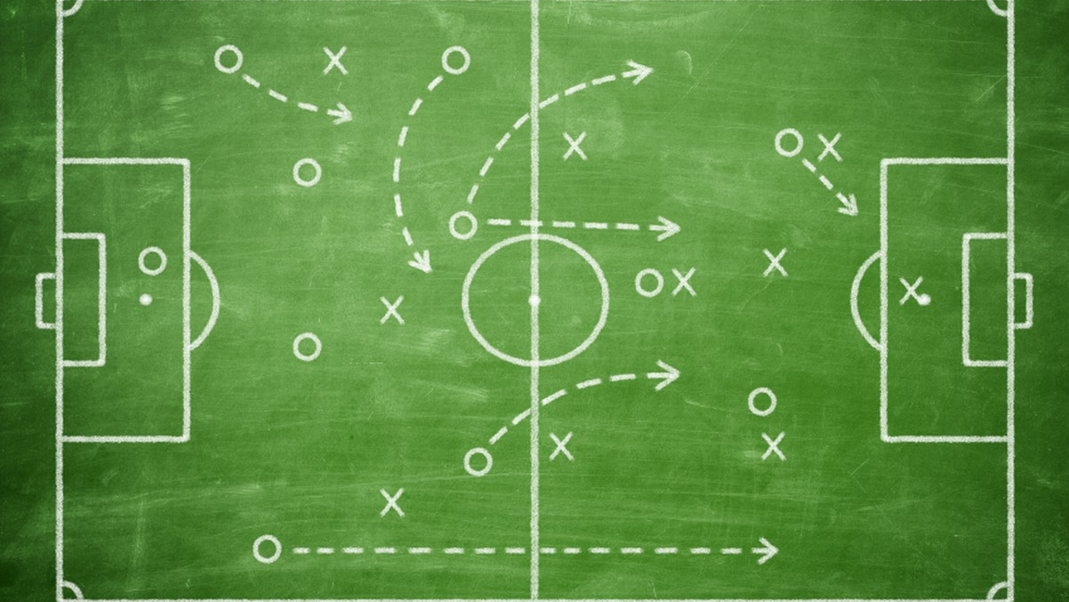
Strategies
-Newsletters
-Autoresponder
-Frequency
-selling
Notes:
Newsletters
-sending out broadcasts to email list in “real-time” (specific dates on a calender) to notify thems of offers, promotions, events and any other types of updates.
Autoresponder Sequences
-predetermined series of emails that each new subscriber will get after signing up
-ensure that every subscriber gets exposed to the same things in the same order
Frequency
-Churn and burn strategy
*mail email list extremally aggressively
-Mail less than daily
*mail once or twice a week?
-Middle Ground
*Once daily on average
Upselling/Cross-selling
-Upselling is offering a relevant product or service after the purchase of another product
-Cross-selling happens any time later in the customer relationship and does not need to involve products that are directly relevant

Slide 5
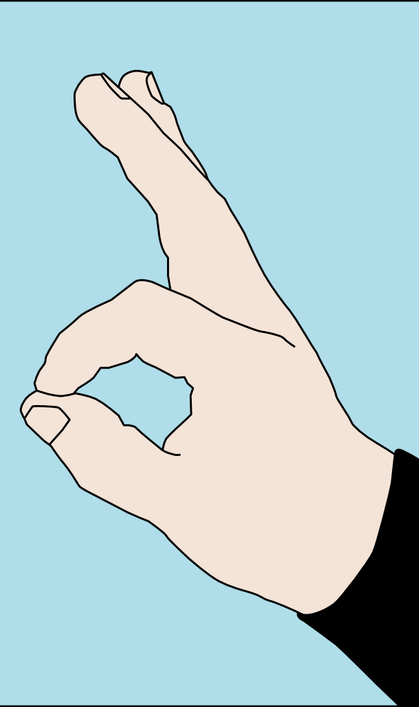
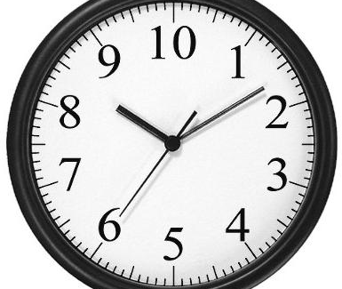
Optimization
Email Etiquette
Timing
Personalization
Notes:
Email Etiquette
-Subject line used (shows professionalism and allows customer to recognize what the email is)
-emails viewable on phones/tablets (used a lot more in today’s day and age
Timing
-depends on your email subscriber list
Personalization
-use of a person’s name has been shown to boost open rates by around 30%
-make it about them
-Any data you collected via an opt-in form, including location, age, gender, birthdays, relationship status, and so on can be utilized to personalize an email.

Slide 6
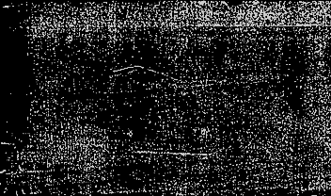

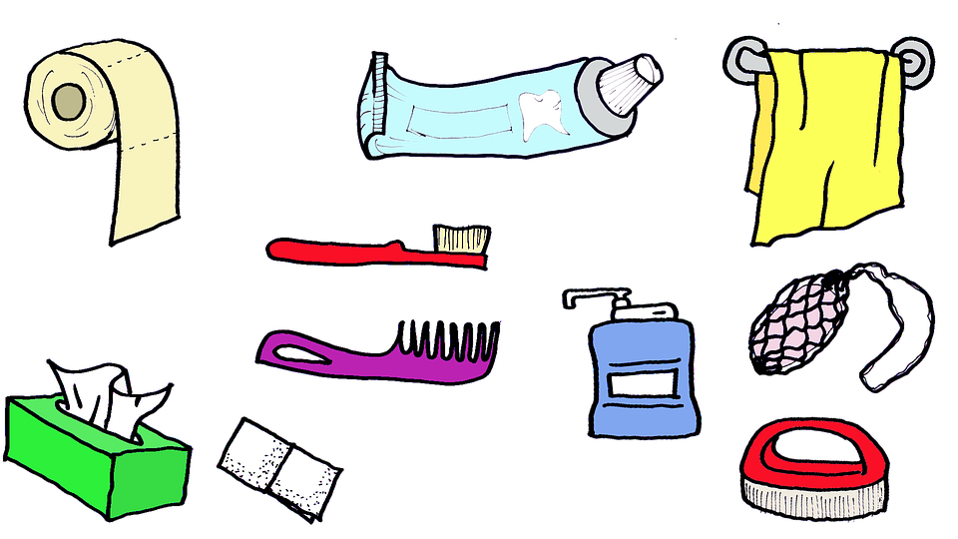
List Maintenance
Good Leads
Segmentation
List Hygiene
Notes:
keeping a happy healthy list overall
Lead Quality
-ensuring your leads are high quality to begin with
-to make sure lead is good have them click a “confirm your request for information” link in an initial email prior to adding lead to list
Segmentation
-To help make sure your subscribers are only getting promotions that are relevant to them, it’s a good idea to segment.
-split email list to groups for what they specifically want
List Hygiene
-Trimming the fat and maintaining a lean, clean, engaged list can do wonders for your deliverability
-get rid of disengaged followers yourself. If you have certain subscribers who have not opened any of your emails in the last few months, delete them

